Slide 1


incremental load in ssis
Presented by:
EL MEKI Youness
Nizar Bennani
Supervised by:
Pr. Nasri Mohammed

Slide 2
Plan
1
2
3
4
problem
solution
process
demo

Slide 3

Problem
The problem incremental load is trying to solve is keeping data between the DATABASE and the Datawarehouse synchronized with one an other while doing it in the most efficient way possible with the minimum resources usage.

Slide 4





solutions
Full load
Partitioning
FULL LOAD
PARTIAL LOAD

Slide 5

Incremental load
In incremental load we only load the new or modified data since the last update as opposed to full load, incremental load uses this two properties lookup and table staging.

Slide 6
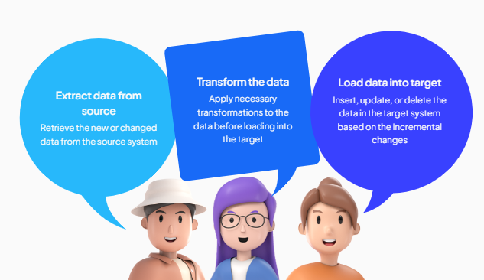
Devolopping an Incremental load package

Slide 7
process

Slide 8
Lookup transformation :
Lookup Source:
The Lookup transformation searches in a data source, typically a table in a database. This source can be a table in the local or remote database, or even a SQL query.
Lookup Key:
The lookup key is the column on which the search is performed. It is usually a primary key or a unique column in the lookup source. The Lookup transformation uses this key to compare values with those in the input source.

Slide 9
Use Cases:
Match Output:
Use the "Match Output" when you want to process rows that have matching records in the lookup source. For example, you may want to update or enrich these records.
No Match Output:
Use the "No Match Output" when you want to handle rows that do not have corresponding matches in the lookup source. For example, you might want to insert these non-matching records into the destination or delete these records .

Slide 10
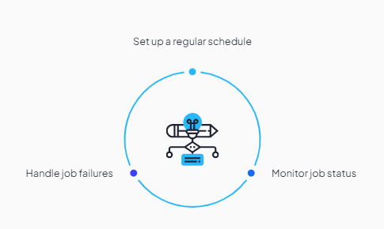
Scheduling
Scheduling is a critical aspect of SSIS package execution, allowing you to automate the running of your packages at specified intervals.

Slide 11
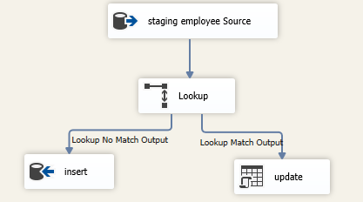
Package structure
Insert & update

Slide 12
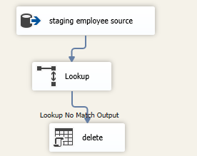
delete

Slide 13
demo

Slide 14
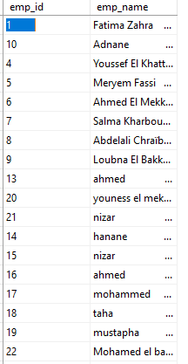
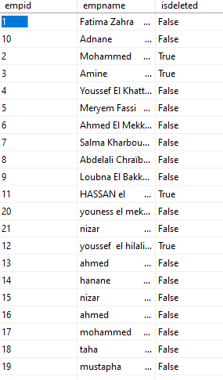
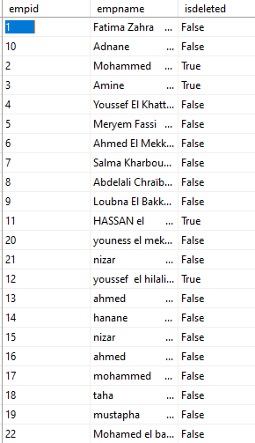
insert

Slide 15
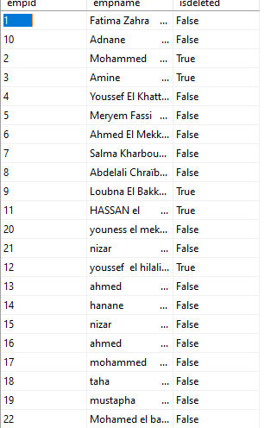
delete

Slide 16
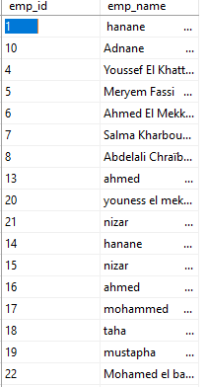
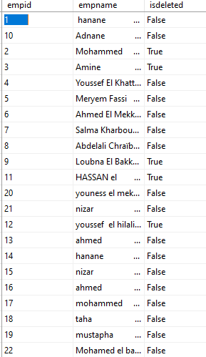
update

Slide 17

Conclusion

Slide 18

Thanks for your attention

